Slide 1


Slide 2
Definition
Immunity is body's ability to resist or eliminate potentially harmful foreign materials or abnormal cells .
eg bacteria, parasites, old cells, dead tissues, cancerous cells and transplant organs

Slide 3
The immune system includes all of the structures and processes that provide a defense against potential pathogens
Two types:
Innate immunity
Acquired immunity.

Slide 4
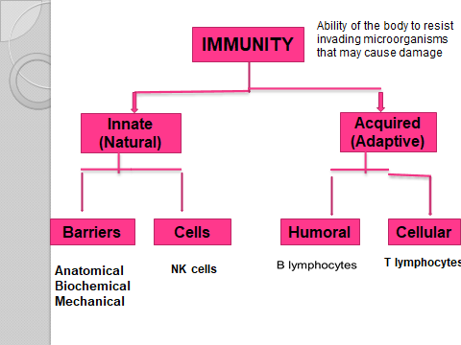

Slide 5
INNAT IMMUNITY
Non specific immunity, includes:
Barriers
Anatomical:
Skin , Mucous Membranes, cilia
Biochemical:
Saliva , Hcl
Mechanical:
Cough , sneezing , vomiting
Cells
NK cells (natural killer cells)

Slide 6
ACQUIRED IMMUNITY
Specific immunity
Directed against a single specific antigen
Requires prior exposure to the antigen
Specific immunity is the function of lymphocytes
2 types of specific immunity:
1- Humoral immunity (B- lymphocyte)
2- Cellular immunity ( T- lymphocyte)

Slide 7
Antigen
Each organism or toxin contains one or more specific protein in its structure (Antigens)that are different from all other compounds.
When a foreign antigen enters into the body it is recognized by the immune system.

Slide 8
Antigens are of two types:
1. Auto antigens or self antigens present on the body’s own cells such as ‘A’ antigen and ‘B’ antigen in RBCs.
2. Foreign antigens or non-self antigens that enter the body from outside.

Slide 9
Humoral immunity
Carried out by B lymphocytes
Forms 25% of the lymphocytes
When the B lymphocytes meet a foreign antigen:
The antigen binds to the receptors on the surface of the cell

Slide 10
The B lymphocytes proliferate and are transformed into plasma cells and memory cells
The plasma cells produce antibodies against that specific antigen
The memory cells live for long time
When the same antigen enters the body again the memory cells are transformed into plasma cells

Slide 11
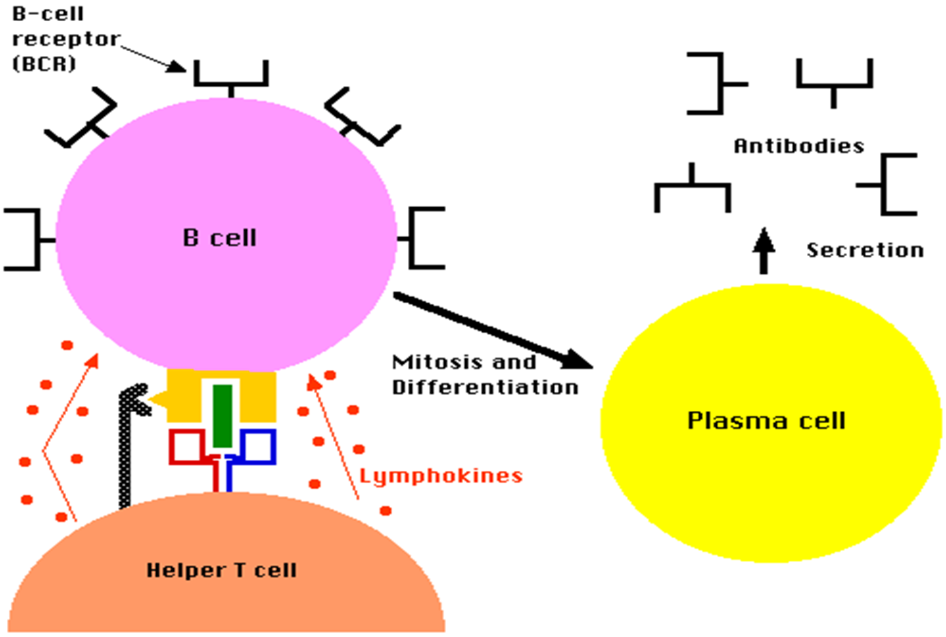

Slide 12
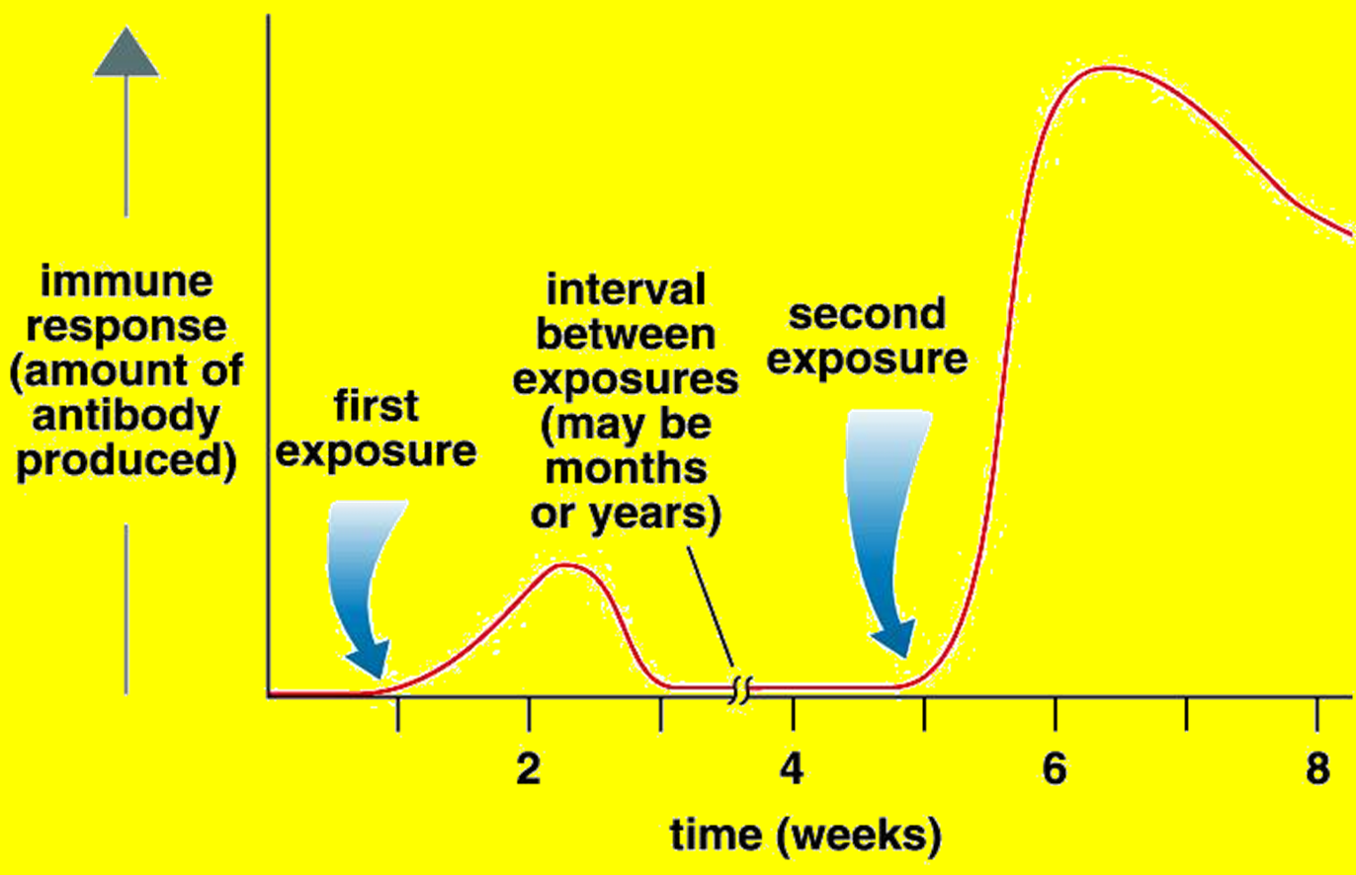
Memory Cells and the Immune Response

Slide 13
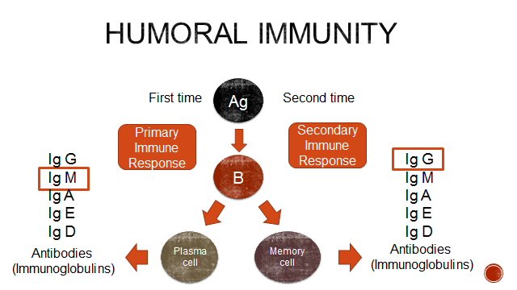

Slide 14
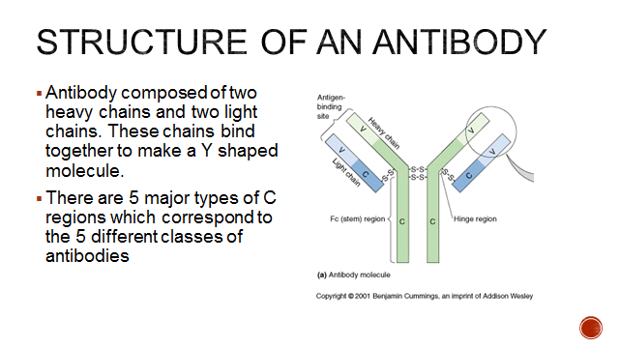

Slide 15
There are 5 classes of antibodies:
1- IgA
2- IgM
3- IgG
4-IgE
5- IgD
(MAGED)

Slide 16
IgG
Most abundant in serum (highest concentration)
Smallest size
Can cross placenta

Slide 17
IgM
Has the largest size
First immunoglobulin class produced in a primary response to an antigen
More effective at stimulating complement system.

Slide 18
IgA
The main antibody in secretions
Found Predominantly in external secretions i.e. Breast Milk (colostrum), Saliva, tears, mucus.

Slide 19
IgE
important in allergic reactions
Mediate the immediate hypersensitivity reactions (asthma, anaphylactic shock)

Slide 20
IgD
Found on surface of mature B-cells
helps in antigen recognition

Slide 21
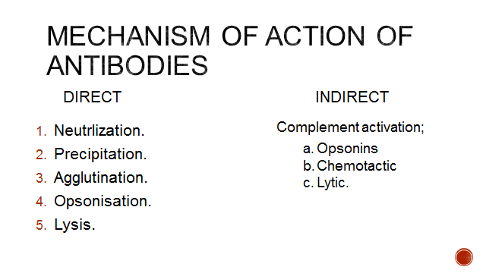

Slide 22
Complement System
is a system of plasma enzymes, which are identified by numbers from C1 to C9.
It accelerates various activities during the fight against the invading organisms

Slide 23
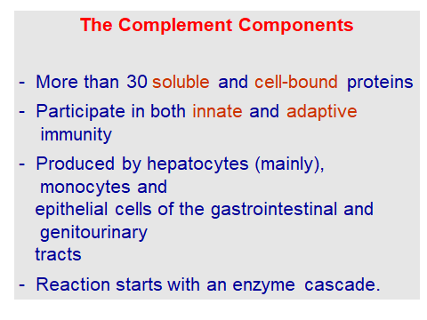

Slide 24
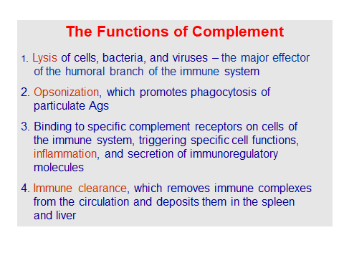

Slide 25
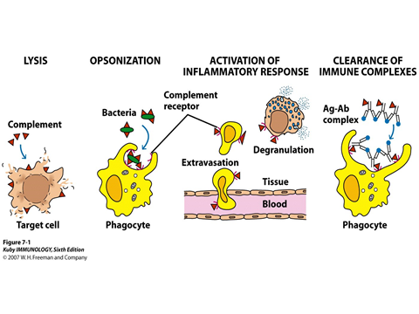

Slide 26
